Slide 1

Language Engineering with
The GEMOC Studio
Tutorial @ MODELS 2017, September 18th, 2017
Benoit Combemale (Univ. Toulouse)
http://www.combemale.fr
benoit.combemale@irit.fr
@bcombemale
Julien Deantoni (Univ. Nice-Sophia-Antipolis)
http://www.i3s.unice.fr/~deantoni/
julien.deantoni@polytech.unice.fr

Slide 2
Tutorial website
https://github.com/gemoc/MODELS2017Tutorial
See:
README
/slides/tutorial-slides.pptx
/code/* ☺

Slide 3
LANGUAGE ENGINEERING

Slide 4

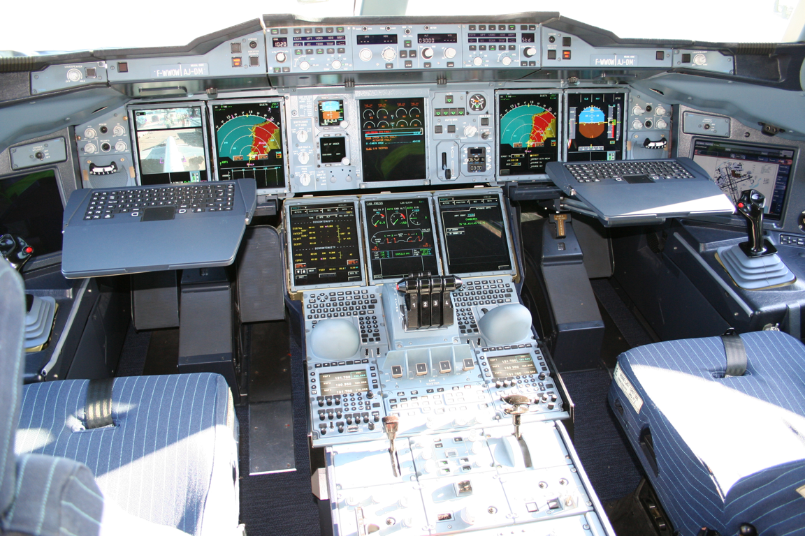

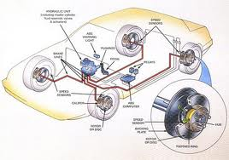
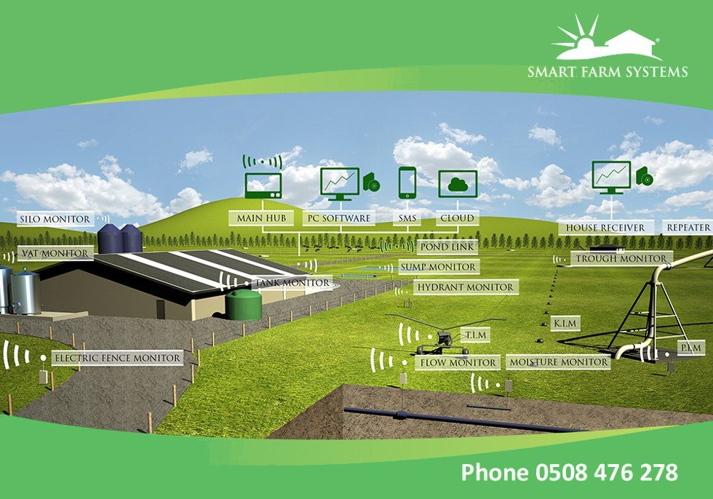
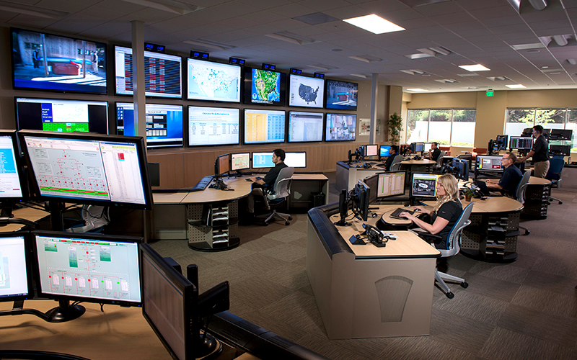
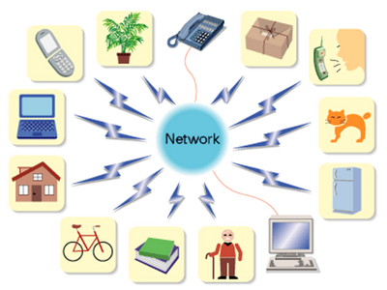
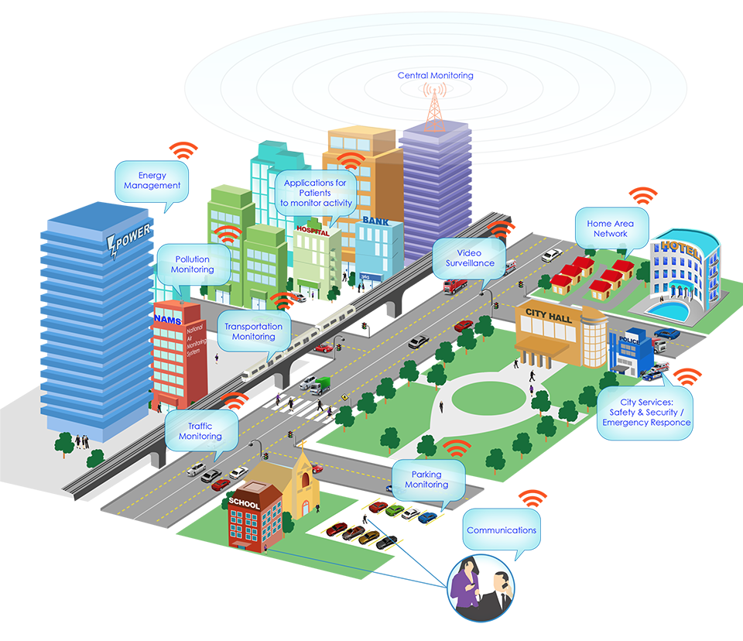

Complex Software-Intensive Systems
Multi-engineering approach
Domain-specific modeling
High variability and customization
Software as integration layer
Openness and dynamicity
- 4

Slide 5


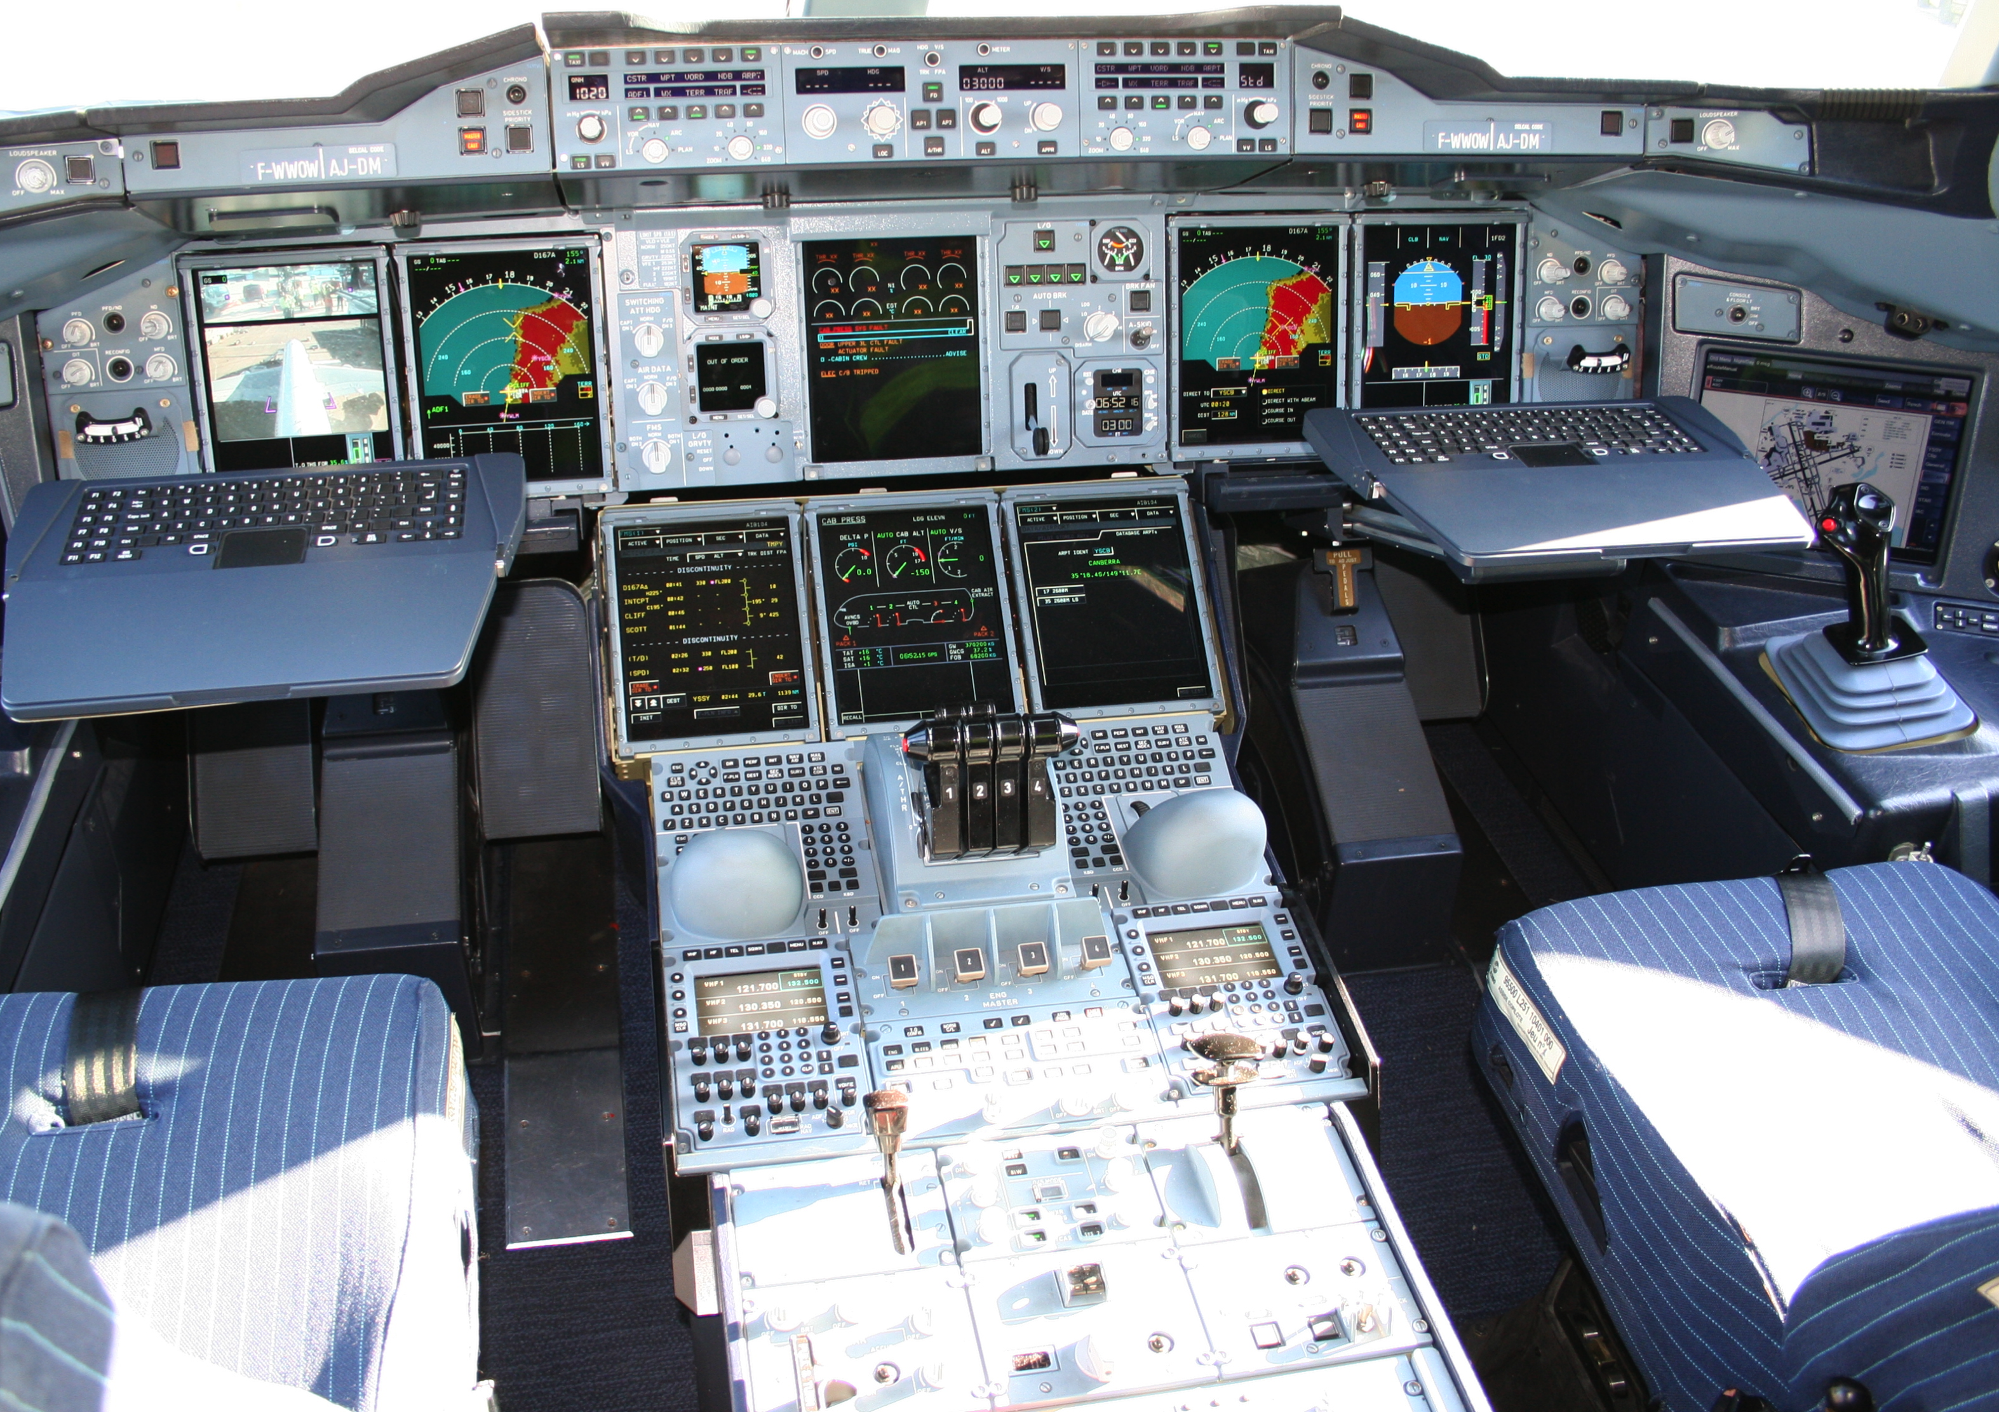









Mechanical
Structure
Airlines
Human-Machine Interaction
Avionics
Multiple
Concerns
Aerodynamics
Environmental
Impact
Propulsion
System
Safety
Regulations
Communications
Authorities
Navigation
Notes:
This piece of complex software integrates different perspectives from these stakeholders
Physics, communications, Pilots -> HCI

Slide 6
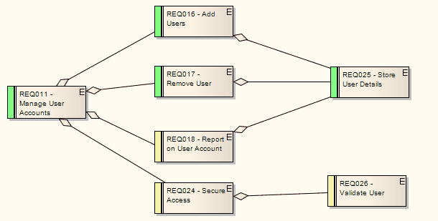
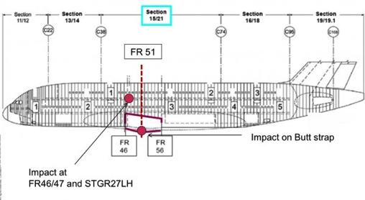
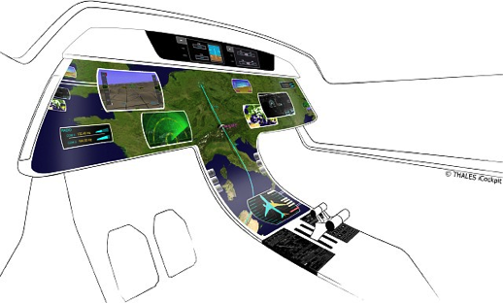
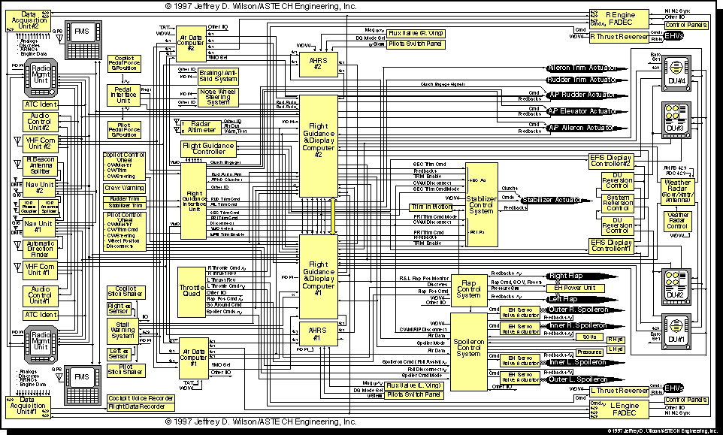
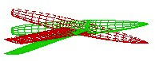
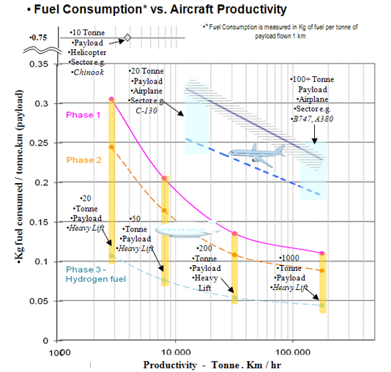
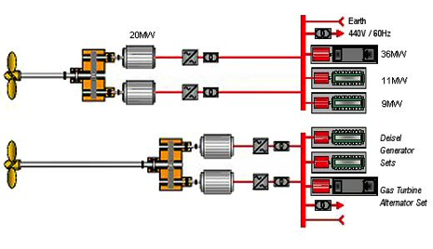
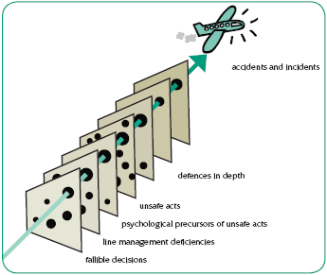
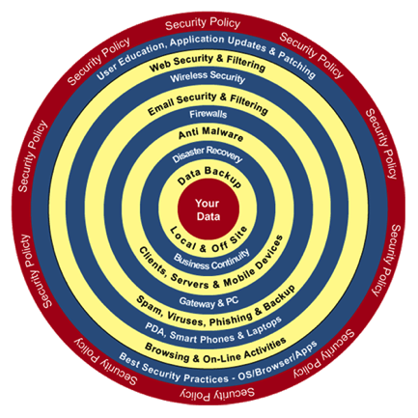
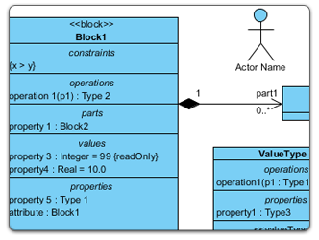
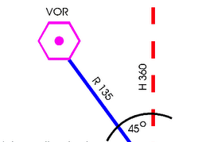
Mechanical
Structure
Airlines
Human-Machine Interaction
Avionics
Heterogeneous Modeling
Aerodynamics
Environmental
Impact
Propulsion
System
Safety
Regulations
Communications
Authorities
Navigation
Notes:
Parler ici du positionnement avec la co-simulation

Slide 7
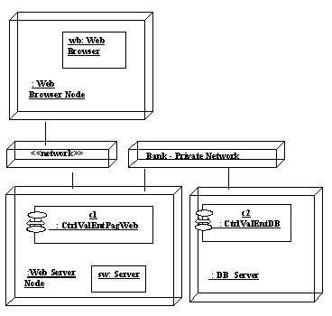
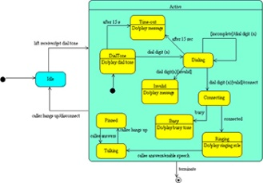
Model-Driven Engineering (MDE)
Security
Distribution
Fault tolerance
Functional behavior
Use case
borrow
return
Platform
Model
deliver
Design Model
reserve
setDamaged
Book
User
state : String
Code Model
"Perhaps surprisingly, the majority of MDE examples in our study followed domain-specific modeling paradigms"
J. Whittle, J. Hutchinson, and M. Rouncefield, “The State of Practice in Model-Driven Engineering,” IEEE Software, vol. 31, no. 3, 2014, pp. 79–85.
Notes:
Oldie but goodie

Slide 8

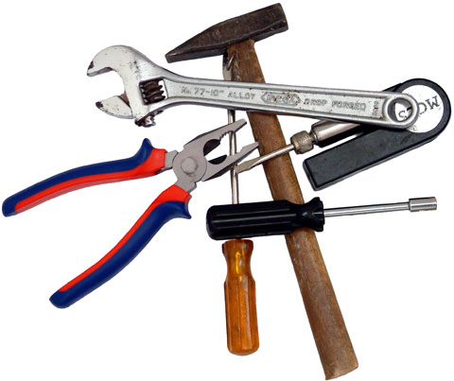
Domain-Specific Languages (DSLs)
Tailored for a particular kind of problem, with dedicated notations (textual or graphical), support (editor, checkers, etc.)
Promises: more « efficient » languages for resolving a set of specific problems in a domain
DSL ~ Modeling Language!

Slide 9
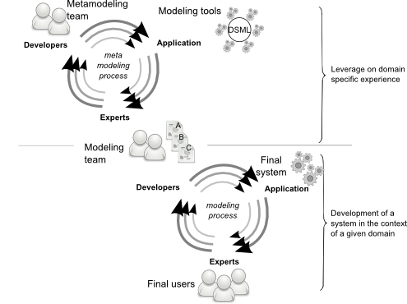
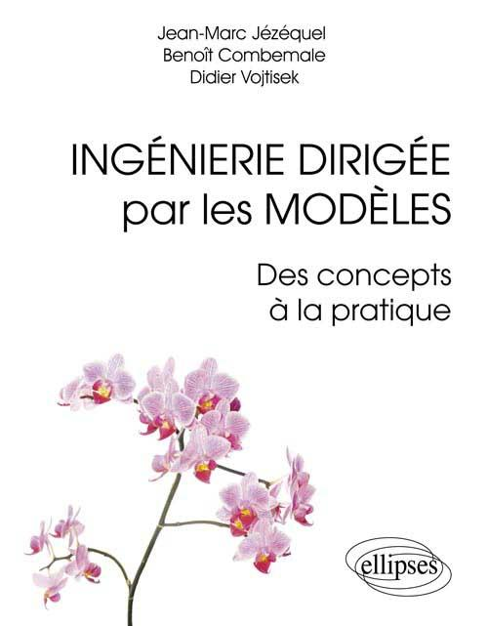
Language-Oriented Programming & Modeling
Ingénierie Dirigée par les Modèles : des concepts à la pratique, by Jézéquel, J.-M., Combemale, B., Vojtisek, D., Références sciences, ellipses (Eds.). 2012.
Engineering Modeling Languages: Turning Domain Knowledge into Tools, by Benoit Combemale, Robert B. France, Jean-Marc Jézéquel, Bernhard Rumpe, Jim R.H. Steel, and Didier Vojtisek. Chapman and Hall/CRC, pp.398, 2016. Companion website: http://mdebook.irisa.fr

Slide 10
Language Design and Implementation
Ingénierie Dirigée par les Modèles : des concepts à la pratique by Jézéquel, J.-M., Combemale, B., Vojtisek, D., Références sciences, ellipses (Eds.). 2012.
Engineering Modeling Languages: Turning Domain Knowledge into Tools, by Benoit Combemale, Robert B. France, Jean-Marc Jézéquel, Bernhard Rumpe, Jim R.H. Steel, and Didier Vojtisek. Chapman and Hall/CRC, pp.398, 2016. Companion website: http://mdebook.irisa.fr

Slide 11
"Software languages are software too"
J-M. Favre, D. Gasevic, R. Lämmel, and E. Pek. "Empirical language analysis in software linguistics," In Software Language Engineering, volume 6563 of LNCS, pages 316–326. Springer, 2011.

Slide 12
Software Language Engineering (SLE)
Application of systematic, disciplined, and measurable approaches to the development, deployment, use, and maintenance of software languages
Various shapes and ways to implement software languages
External, internal or embedded DSLs, Profile, etc.
Grammar, metamodel, ontology, etc.
Supported by various kind of "language workbench"
Eclipse EMF, Xtext, Sirius, Melange, GEMOC, Papyrus
Jetbrain’s MPS
Spoofax
MS DSL Tools
Etc.
More and more literature, a dedicated Intl. conference (ACM SLE, cf. http://www.sleconf.org)…

Slide 13
GEMOC

Slide 14

The GEMOC initiative
An open and international initiative to
foster globalization of DSMLs in open world
impossible a priori unification
requires a posteriori globalization
coordinate (between members) and disseminate (for the members)
Organizes
workshop series
Seminars at Dagstuhl, Bellairs
http://gemoc.org @gemocinitiative

Slide 15
The GEMOC Research Challenges
Modular language design and implementation
Language interfaces
Composition operators (for reuse/variability management, for coordination, …)

Slide 16

The GEMOC Eclipse Research Consortium
Sustain the GEMOC initiative as a research platform
Project commitment
Own budget for maintaining the studio and the dissemination
- 16

Slide 17



The GEMOC Studio
http://gemoc.org/studio
Language
Workbench
Modeling
Workbench
Design and compose your executable DSMLs
Edit and debug
your heterogeneous models

Slide 18

The GEMOC Eclipse Project
http://eclipse.org/gemoc
Sustain the GEMOC studio as a research platform
To support experimentations of new solutions by academics
To support pilot projects by industry
To foster relationships between academia and industry
To help industrial transfer and innovation

Slide 19
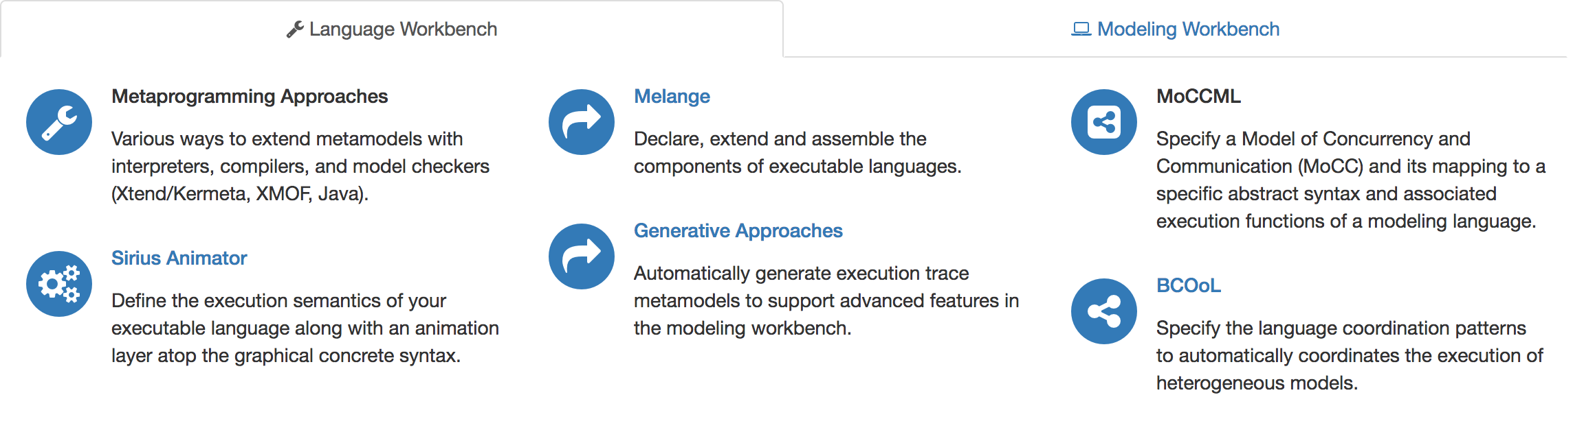
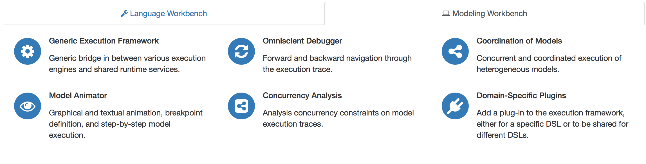

The GEMOC Studio: Major Components

Slide 20
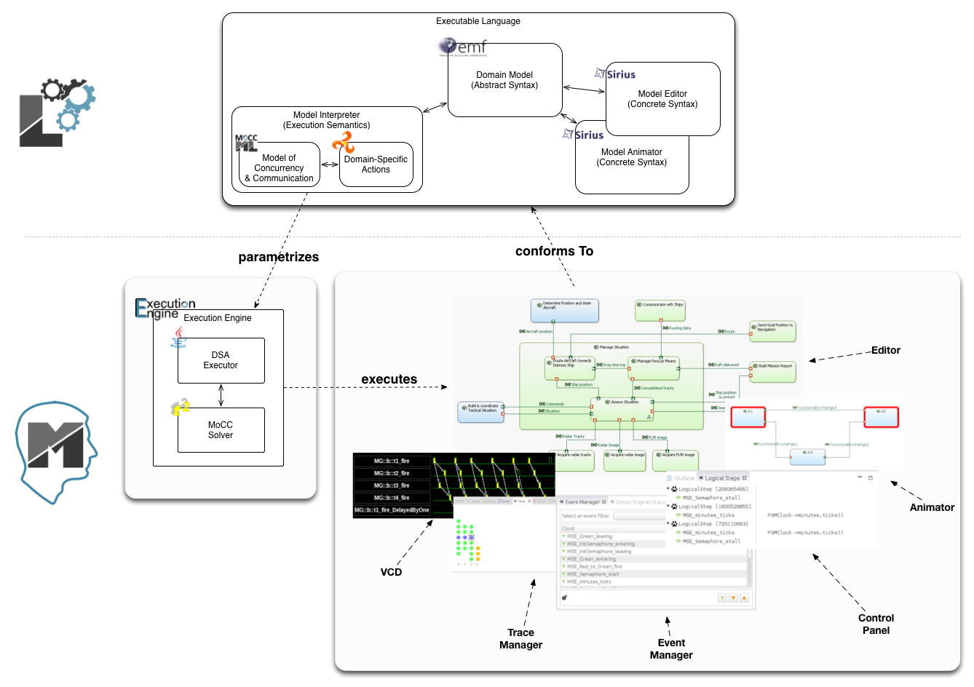
The GEMOC Studio
Benoit Combemale, Julien Deantoni, Olivier Barais, Arnaud Blouin, Erwan Bousse, Cédric Brun, Thomas Degueule and Didier Vojtisek, "A Solution to the TTC'15 Model Execution Case Using the GEMOC Studio," In 8th Transformation Tool Contest (TTC), 2015. Overall Winner
http://gemoc.org/studio/

Slide 21
Breathe Life Into Your Designer!

Slide 22
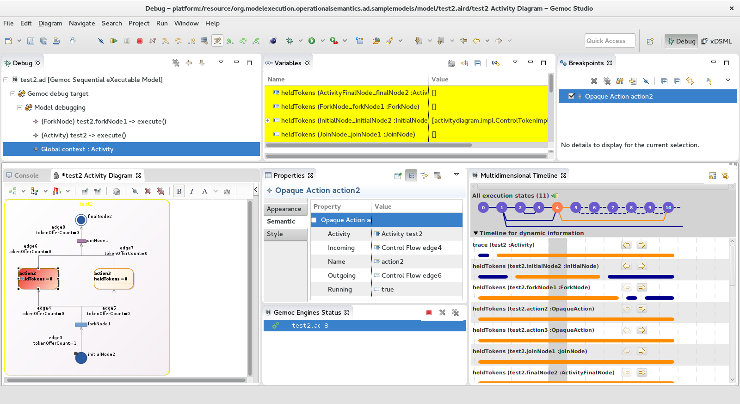
Activity Diagram Debugger
https://github.com/gemoc/activitydiagram

Slide 23
Reifying Concurrency in xDSML: Limitations
Concurrency remains implicit and ad-hoc in language design and implementation:
Design: implicitly inherited from the meta-language used
Implementation: mostly embedded in the underlying execution environment
The lack of an explicit concurrency specification in language design prevents:
leveraging the concurrency concern of a particular domain or platform
a complete understanding of the behavioral semantics
effective concurrency-aware analysis techniques
effective techniques for producing semantic variants
analysis of the deployment on parallel architectures

Slide 24
Reifying Concurrency in xDSML: Approach

Slide 25
Weave Concurrency Constraints Into Your DSL!
Benoit Combemale, Julien Deantoni, Matias Vara Larsen, Frédéric Mallet, Olivier Barais, Benoit Baudry, Robert France, "Reifying Concurrency for Executable Metamodeling," In Software Language Engineering (SLE), 2013

Slide 26
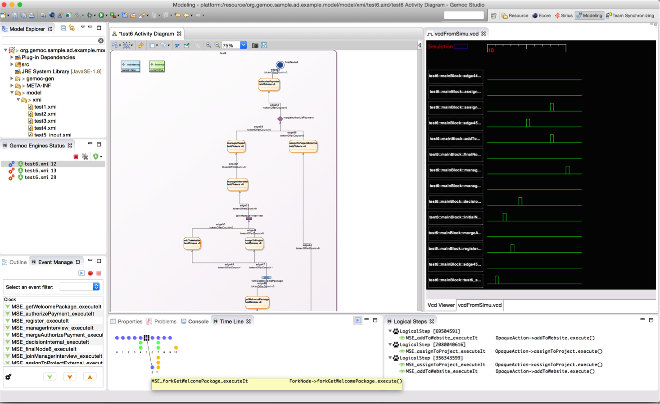
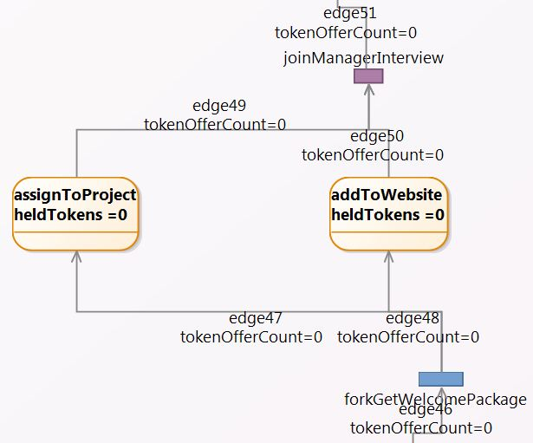
Activity Diagram Debugger
Benoit Combemale, Julien Deantoni, Matias Vara Larsen, Frédéric Mallet, Olivier Barais, Benoit Baudry, Robert France, "Reifying Concurrency for Executable Metamodeling," In Software Language Engineering (SLE), 2013

Slide 27
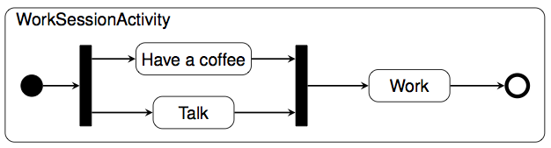
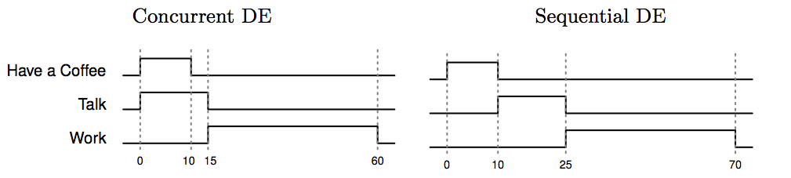
Coping with Semantic Variation Points
Florent Latombe, Xavier Crégut, Julien Deantoni, Marc Pantel, Benoit Combemale, "Coping with Semantic Variation Points in Domain-Specific Modeling Languages", In EXE@MoDELS 2015.

Slide 28
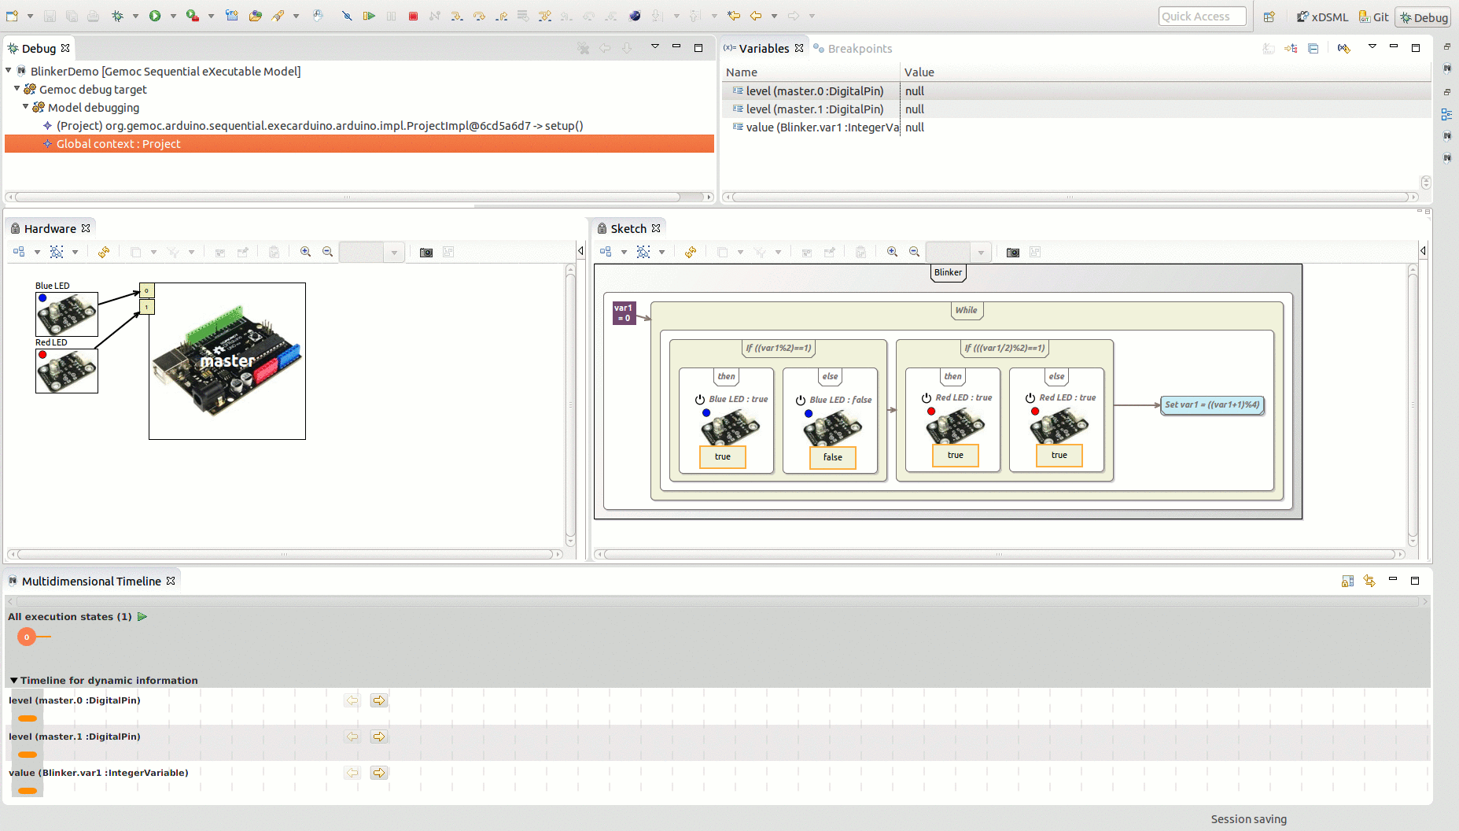
Arduino Designer (& Debugger)
https://github.com/gemoc/arduinomodeling

Slide 29
Transformation Lg Debugger
TETRABox
http://modeltransformation.net/tetrabox/
Wimmer, Bousse et al.
https://github.com/tetrabox/minitl

Slide 30
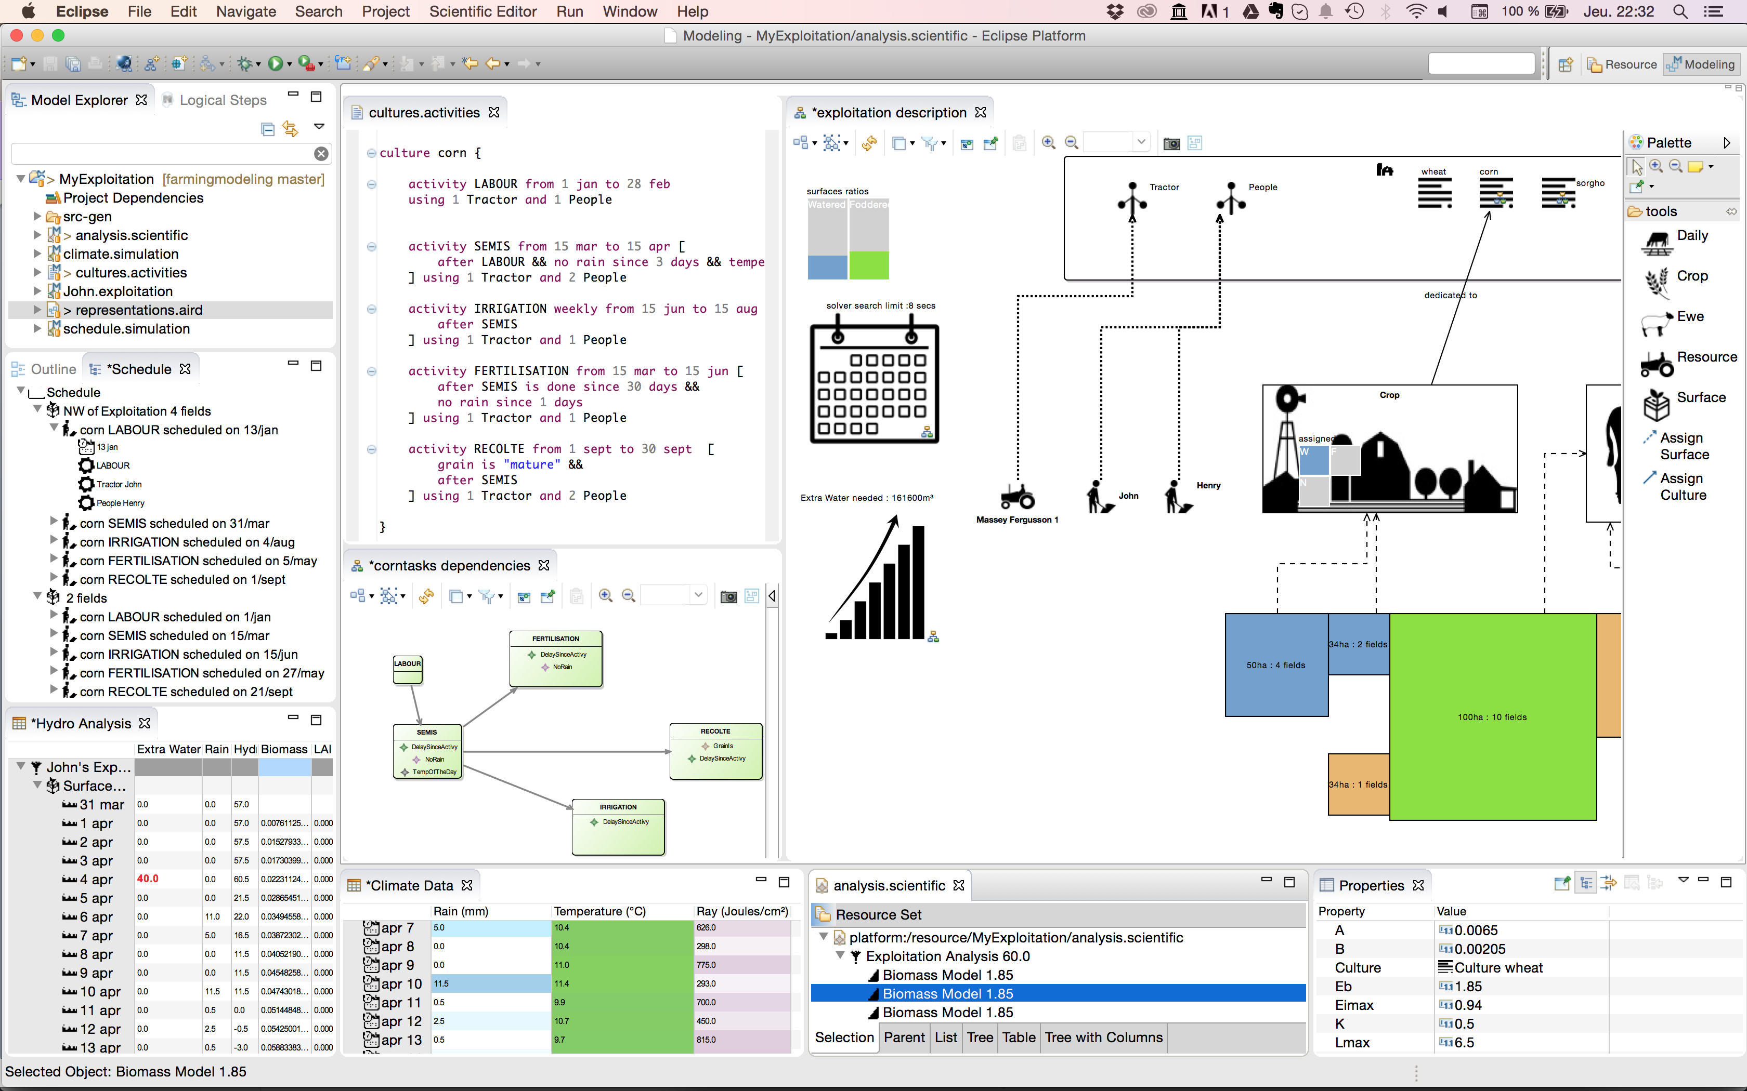
Farming System Modeling
https://github.com/gemoc/farmingmodeling

Slide 31

Behavioral Model Coordination
Matias Ezequiel Vara Larsen, Julien Deantoni, Benoit Combemale, Frédéric Mallet, "A Behavioral Coordination Operator Language (BCOoL)," In MODELS 2015

Slide 32
The GEMOC Studio
EMF, Xtext, Sirius
Metaprogramming Approaches (Xtend/K3, ALE, XMOF, Java)
Sirius Animator (graphical animation)
Melange (language reuse)
Generative Approaches (execution trace, checking)
MoCCML (concurrency analysis)
BCOoL (behavioral coordination)
Generic Execution Framework
Graphical animation
Breakpoint definition on model element
Multi-dimensional and efficient trace management
Model omniscient debugging facilities (incl., timeline, step backward, stimuli management, etc.)
Concurrency Analysis
Coordination of Models
Domain-Specific Plugins
Benoit Combemale, Julien Deantoni, Olivier Barais, Arnaud Blouin, Erwan Bousse, Cédric Brun, Thomas Degueule and Didier Vojtisek, "A Solution to the TTC'15 Model Execution Case Using the GEMOC Studio," In 8th Transformation Tool Contest (TTC), 2015. Overall Winner
http://gemoc.org/studio

Slide 33


Slide 34
This tutorial
See how EMF+GEMOC technologies help to (semi-automatically) build the tooling for a DSL IDE
Build an executable DSL, and see how GEMOC provides
an execution engine,
A concurrency constraint solver,
a graphical model animator,
an omniscient debugger.
Materials are available from https://github.com/gemoc/MODELS2017Tutorial

Slide 35
You will learn how to
Build or customize your own abstractions, or even software languages and development environments, to build complex, domain-specific, software-intensive systems
Apply language formalisms, paradigms and principles
Extend a graphical, executable DSL using state of the art techniques
Manage the industrial complexity of developments and associated toolchains

Slide 36
A few notes on the tutorial
Interweave a total of 2*30 min introduction / conclusion to SLE and GEMOC and 2*1h hands-on time
Creating a sufficiently interesting, yet full-blown, modeling language including syntax, semantics, and editor/animator in 120 minutes is challenging to impossible
To introduce the quintessential aspects of language engineering to you, your can directly access to clear workspaces at the different stages of the languages under development. Please look out for the following symbol: on the tutorial website https://github.com/gemoc/MODELS2017Tutorial

Slide 37
Eclipse as a platform
Integrated development platform with base workspace and an extensible plug-in system
Contribute to existing IDE
Open structure with third party contributions
Update site, market place, …
Or create your own application
Rich Client Platform (RCP) for general purpose applications
Don’t be afraid of the number of workspace projects
Most of them are due to splitting the java packages for easier deployment and dependency management.

Slide 38
Modeling workbench vs. language workbench
We use eclipse as a language workbench in which we define the constituents of and services for languages in form of eclipse plugins.
From this we start another eclipse instance – the modeling workbench.
Into this, we deploy the tools and services to create models conforming to the language(s) defined in the language workbench.

Slide 39

Hands on - content
Teaser: xFSM Example
Abstract syntax: Ecore
Graphical concrete syntax: Sirius
Execution semantics: Kermeta/MoCCML
2 parts:
Breathe Life Into Your Designer!
Weave Concurrency Constraints Into Your DSL!

Slide 40
Breathe Life Into Your Designer!

Slide 41
Program outline (see README)
2.1. Overview the language example provided for the tutorial
2.2. Playing with the modeling workbench
2.3. Complementing the execution semantics
2.4. Deploying the modeling workbench and playing with the example model

Slide 42
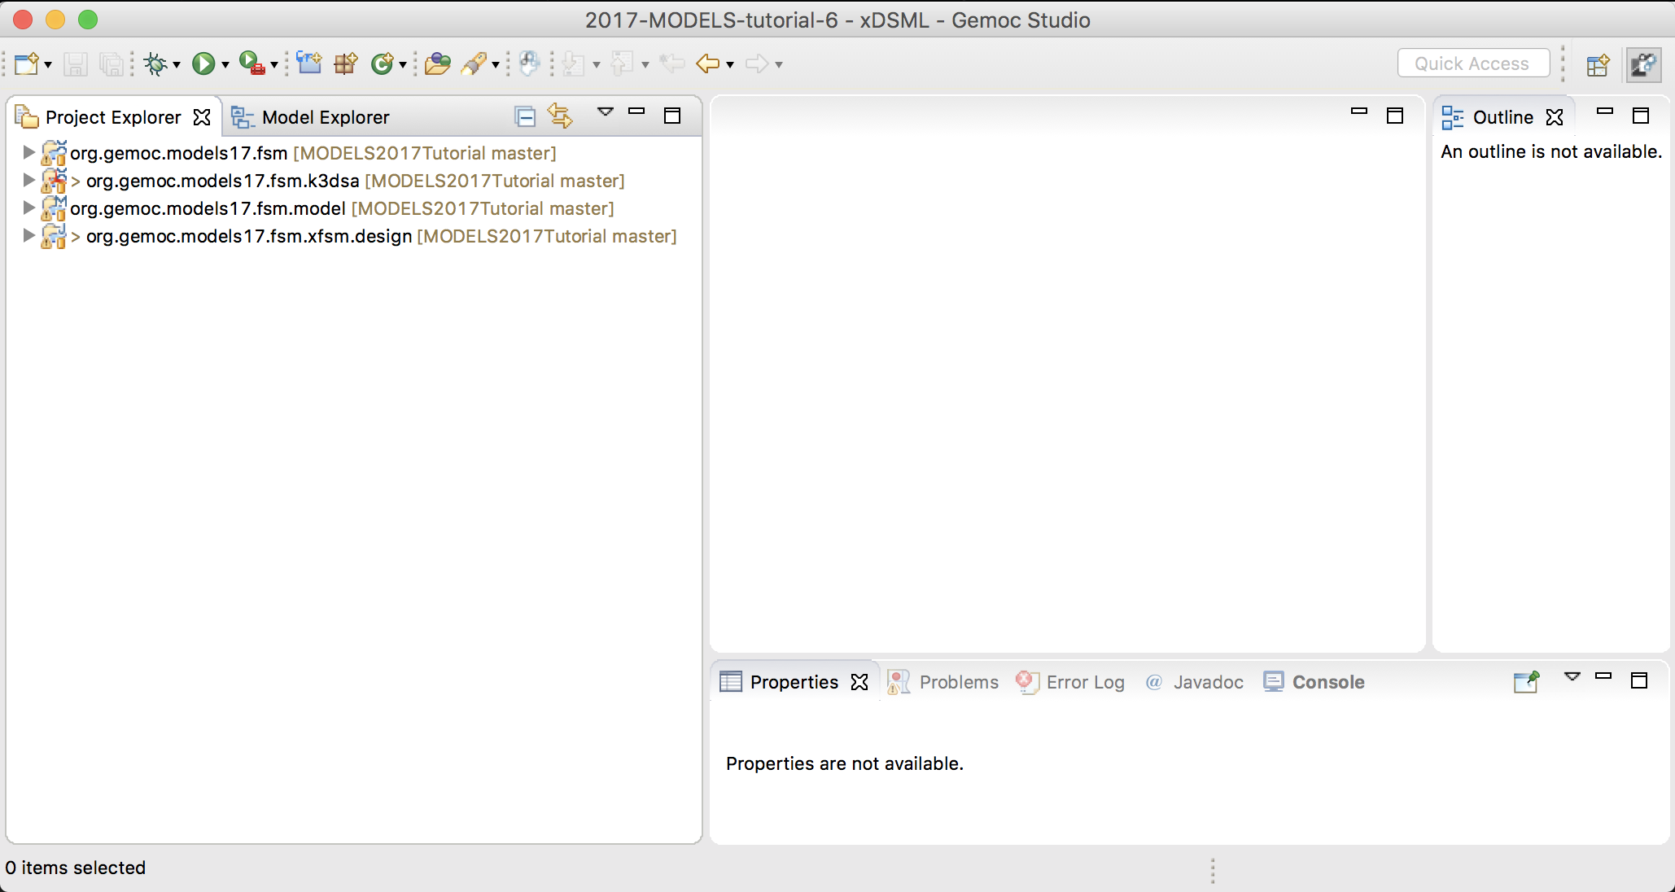
2.1. Overview the language example provided for the tutorial
Clone the Github repo of the tutorial
Start the GEMOC Studio on a fresh workspace
Import in your workspace the projects from /code/languagewb/*

Slide 43
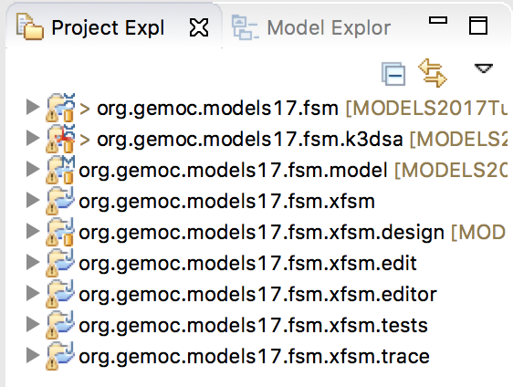
2.1. Overview the language example provided for the tutorial
Generate the structural interface of your language
Melange file -> Melange -> Generate All
Generate the domain-specific trace backend
Melange file -> GEMOC Language -> Generate Multidimensional Trace Addon project for language
Generate the EMF edition layer
Open org.gemoc.models17.fsm.xfsm/model/Model.genmodel
Right clic on the root -> Generate All

Slide 44
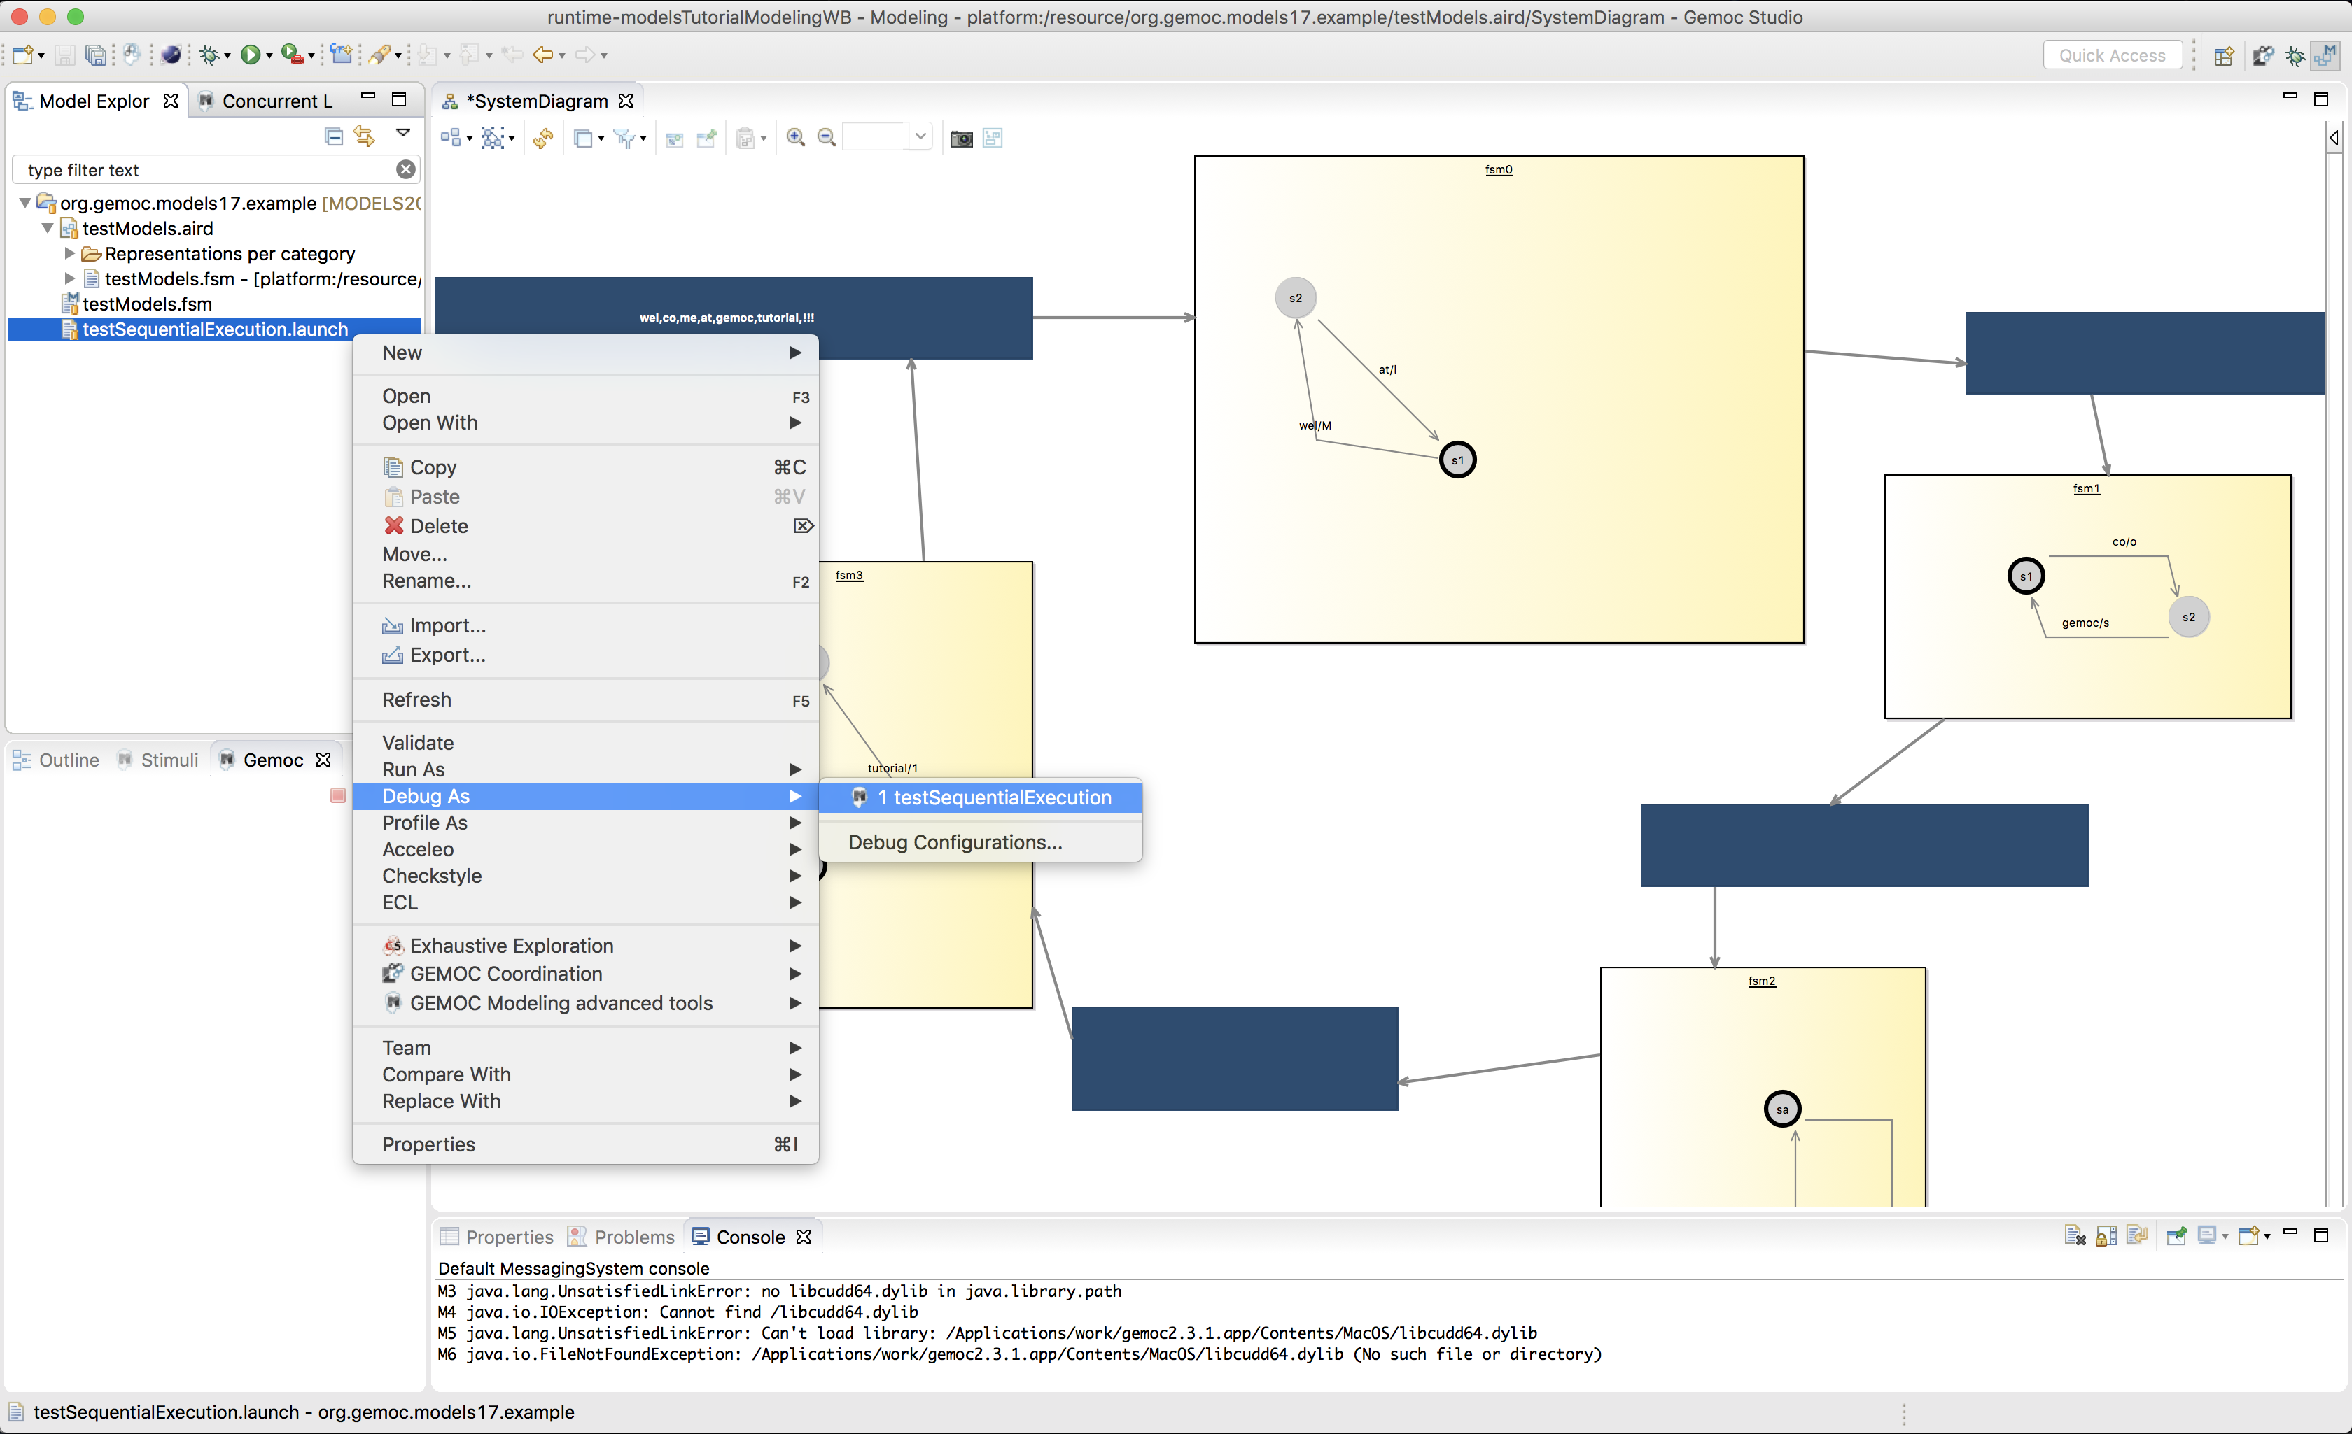
2.2. Playing with the modeling workbench
Launch a new Eclipse instance (use the launch config modelsTutorialModelingWB)
Import the model example (project code/modelingwb/ org.gemoc.models17.example)
Open the testModels.aird, and then the diagram (systemDiagram)
Start the launch configuration in debug mode

Slide 45
2.3. Complementing the execution semantics
TODO

Slide 46
2.4. Deploying the modeling workbench and playing with the example model
Do 2.1 > step 4 (each time you modify the semantics)
Do 2.2
See the diff ☺

Slide 47
Weave Concurrency Constraints Into Your DSL!

Slide 48
TODO
(see https://github.com/gemoc/MODELS2017Tutorial)

Slide 49
Conclusion

Slide 50
TODO
BCOOL

Slide 51

Hack your own languages?
Join us in the MDE/SLE group of the CNRS IRIT lab, in a freshly rebuilt campus of the warm city of Toulouse!
Open Positions
for PhD and Postdoc
Benoit Combemale
Professor, Univ. Toulouse, France
http://combemale.Fr
benoit.combemale@irit.fr
@bcombemale

Slide 52
Running the FSM Example
STEP 2.1

Slide 53
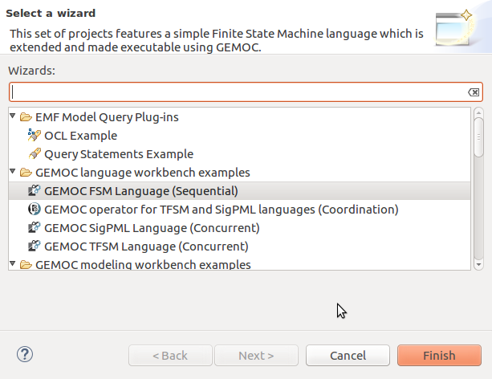
Load the FSM language
(see https://github.com/gemoc/MODELS2017Tutorial)

Slide 54
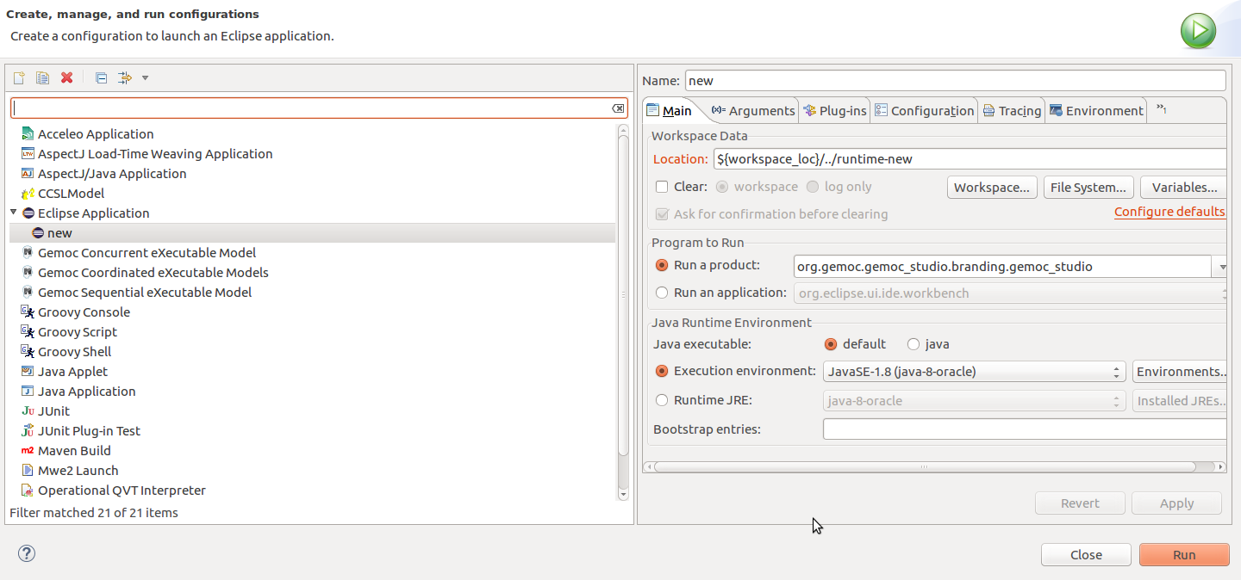
Start the modeling workbench
(see https://github.com/gemoc/MODELS2017Tutorial)

Slide 55
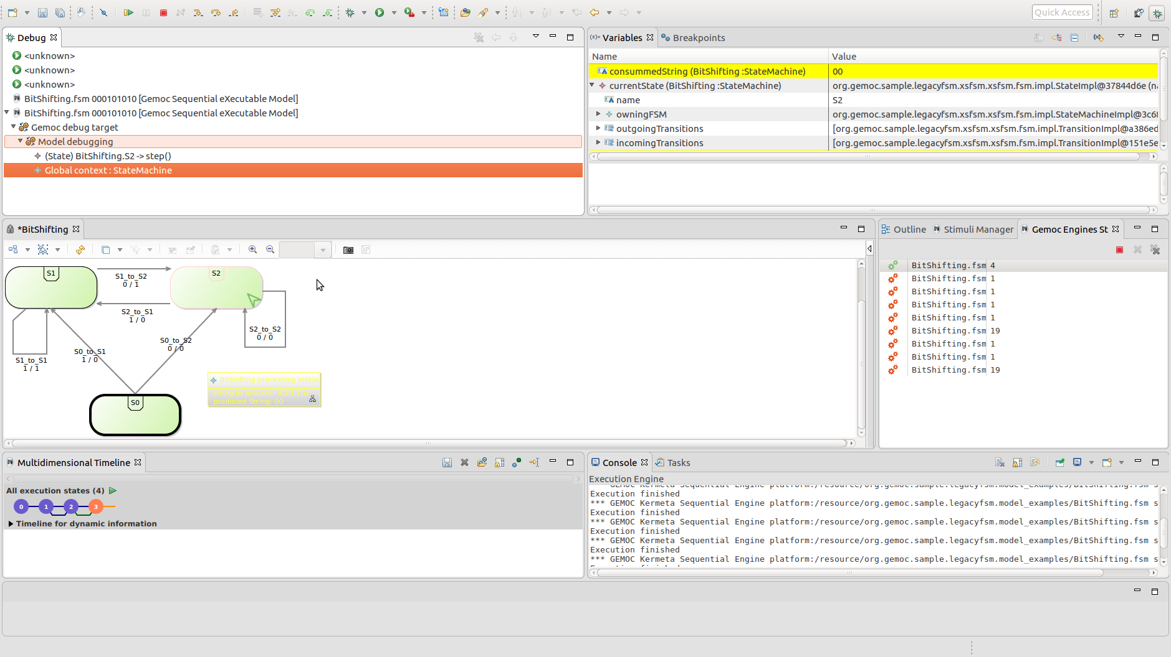
Examine and run your models
stack trace
variable values
graphical model representation
execution trace
(see https://github.com/gemoc/MODELS2017Tutorial)

Slide 56
ABSTRACT SYNTAX EXTENSION
STEP 2.2

Slide 57
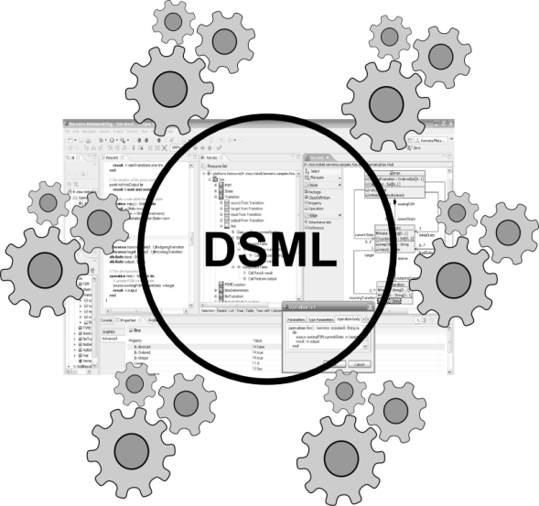
Abstract syntax defines your domain
We use Ecore to define the concepts and relations of the domain of FSMs
Alternatives are MOF, grammars, …
Editors
(textual, graphical, …)
Checkers
(static & dynamics)
Documentation generators
Compilers
Test generators
Translators
Simulators
Code generators
Analyzers
Refactoring
Etc.

Slide 58
Ecore/EMF
EMF serves as the foundation: It provides the Ecore meta-metamodel (basically a Class diagram ), and frameworks and tools around it :
EMF provides almost for free (among other features)
Serialization (XMI)
Tree editor
either reflective, or generated with possibility to customize
Edition support (outline, notification API for other editors, …)
Java manipulation API
EMF compatible projects use this as a base to propose extended services

Slide 59
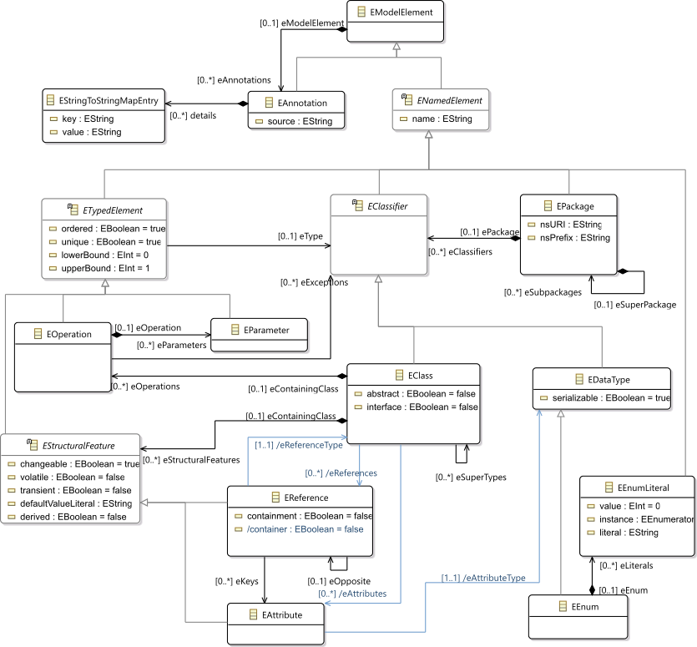
Ecore most used concepts
(removed most helper derived features, operations and generic support)

Slide 60
OCL invariants
Class diagram structure implies design choices
Invariants (e.g., in OCL) can complement it in order to enforce the consistency of models
Editors
(textual, graphical, …)
Checkers
(static & dynamics)
Documentation generators
Compilers
Test generators
Translators
Simulators
Code generators
Analyzers
Refactoring
Etc.

Slide 62
Extend FSM abstract syntax
Add concepts for variables, guards, and actions to your FSM language
Use the graphical metamodel editor
Add an OCL invariant to your language

Slide 63
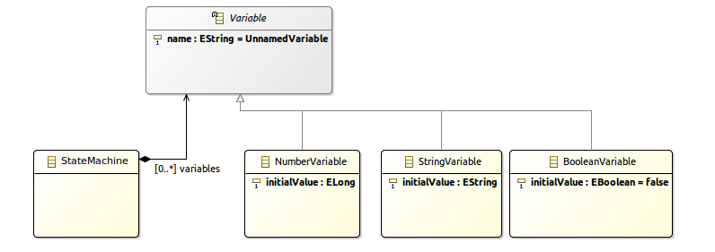
Add concept Variable
(see https://github.com/gemoc/MODELS2017Tutorial)

Slide 64
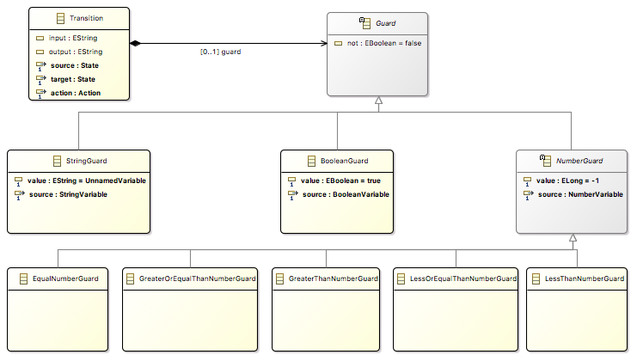
Add concept Guard
(see https://github.com/gemoc/MODELS2017Tutorial)

Slide 65
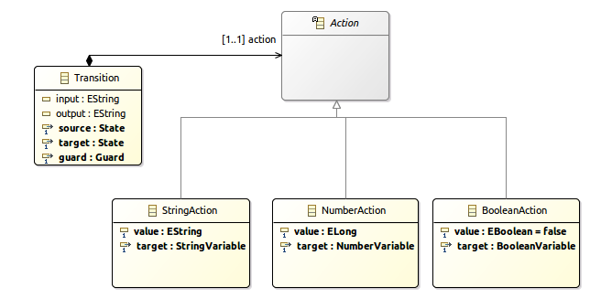
Add concept Action
(see https://github.com/gemoc/MODELS2017Tutorial)

Slide 66
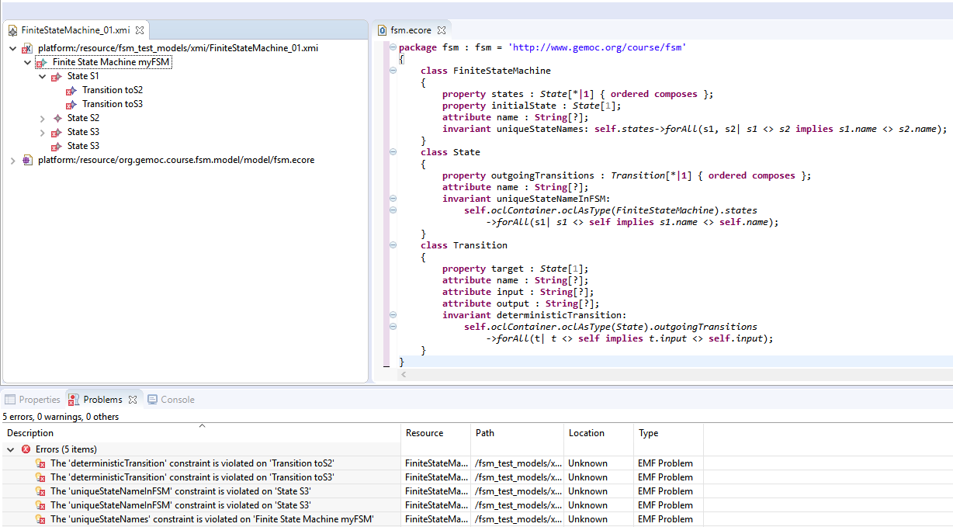
Add OCL invariant
Use the OCLInEcore editor
Add invariant: states cannot have two outgoing transitions without a guard
Syntax example: check name uniqueness
invariant uniqueStateNames:
self.states->forAll(s1, s2| s1 <> s2 implies s1.name <> s2.name);
(see https://github.com/gemoc/MODELS2017Tutorial)

Slide 67
DYNAMIC SEMANTICS EXTENSION
STEP 2.3

Slide 68
Adding behavior to models
Two main ways to add behavior
Operational, i.e., an interpreter
Translational, i.e., a compiler
Editors
(textual, graphical, …)
Checkers
(static & dynamics)
Documentation generators
Compilers
Test generators
Translators
Interpreters
Code generators
Analyzers
Refactoring
etc.

Slide 69
Adding operational behavior to models
Usually abstract syntax traversal navigating the model
Adding operations to the Ecore metamodel enables adding behavior to the language
but breaks separation of concerns and language reuse
Traditional approaches: visitor design pattern
However, it doesn't scale to
runtime performance
multiple metamodels
language composition
modular evolution with new functionality
Notes:
Expression problem of OO

Slide 70
Meet Kermeta and Melange
Kermeta
Advanced visitor pattern to add aspect oriented behavior
see classes as if they where "reopened" and extended
Supports adding operations, attributes, associations, inheritance
@Main denotes entry points
@Step execution functions represented as visible steps
Melange
Language assembly: compose static metamodel (Ecore) with dynamic aspects (Kermeta) to generate a language implementation
Language composition: inheritance, merge, slice…

Slide 71
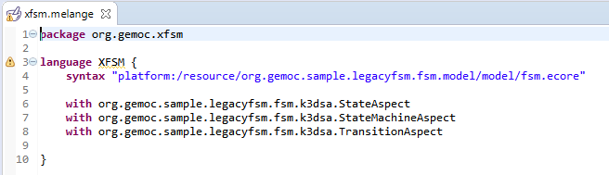
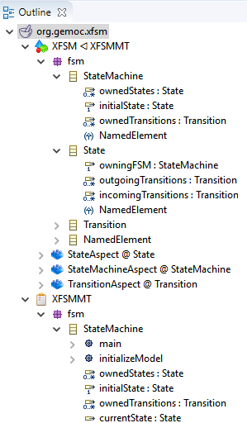
Combining language parts with Melange
xx
Adds operation and attributes
may add new concepts too by using multiple Ecore files
Melange generates the new resulting implementation

Slide 73
Extend FSM dynamic semantics
The FSM aspects are defined in the file tfsmAspects.xtend of project org.gemoc.sample.legacyfsm.fsm.k3dsa
Investigate these (watch for @Main and @Step)
Two methods are not implemented (marked ”TODO”): please implement these
(see https://github.com/gemoc/MODELS2017Tutorial)

Slide 74
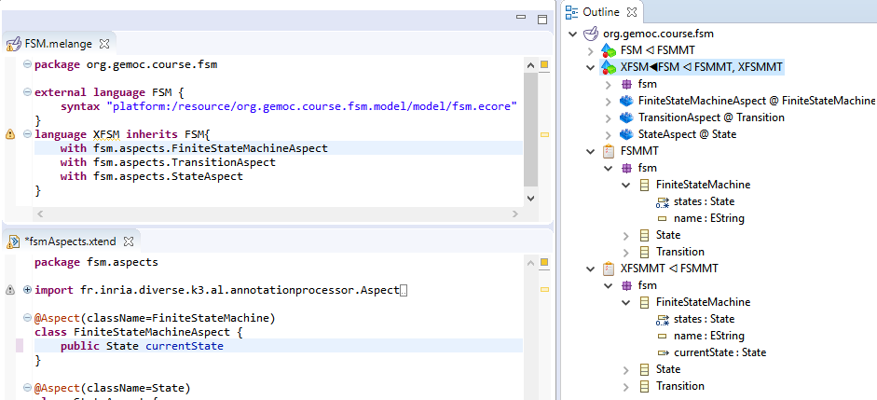
Edit Kermeta aspects
(see https://github.com/gemoc/MODELS2017Tutorial)

Slide 75
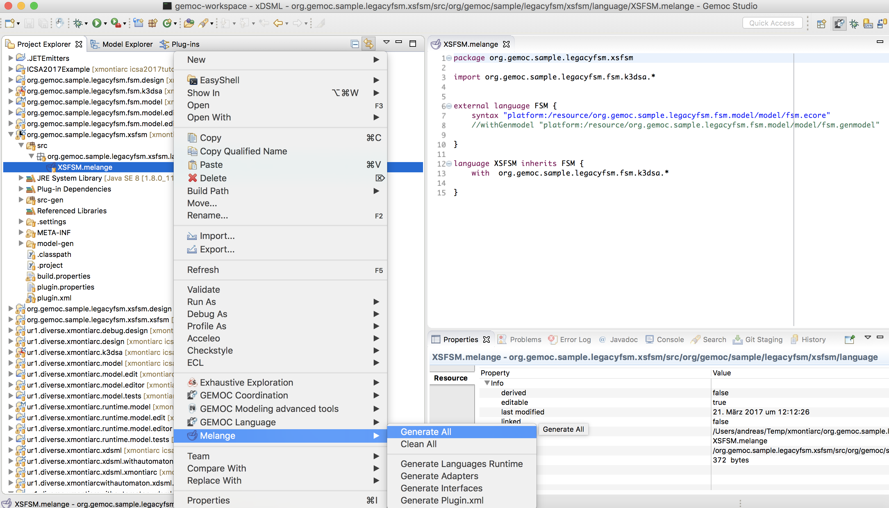
Generate executable language
(see https://github.com/gemoc/MODELS2017Tutorial)

Slide 76
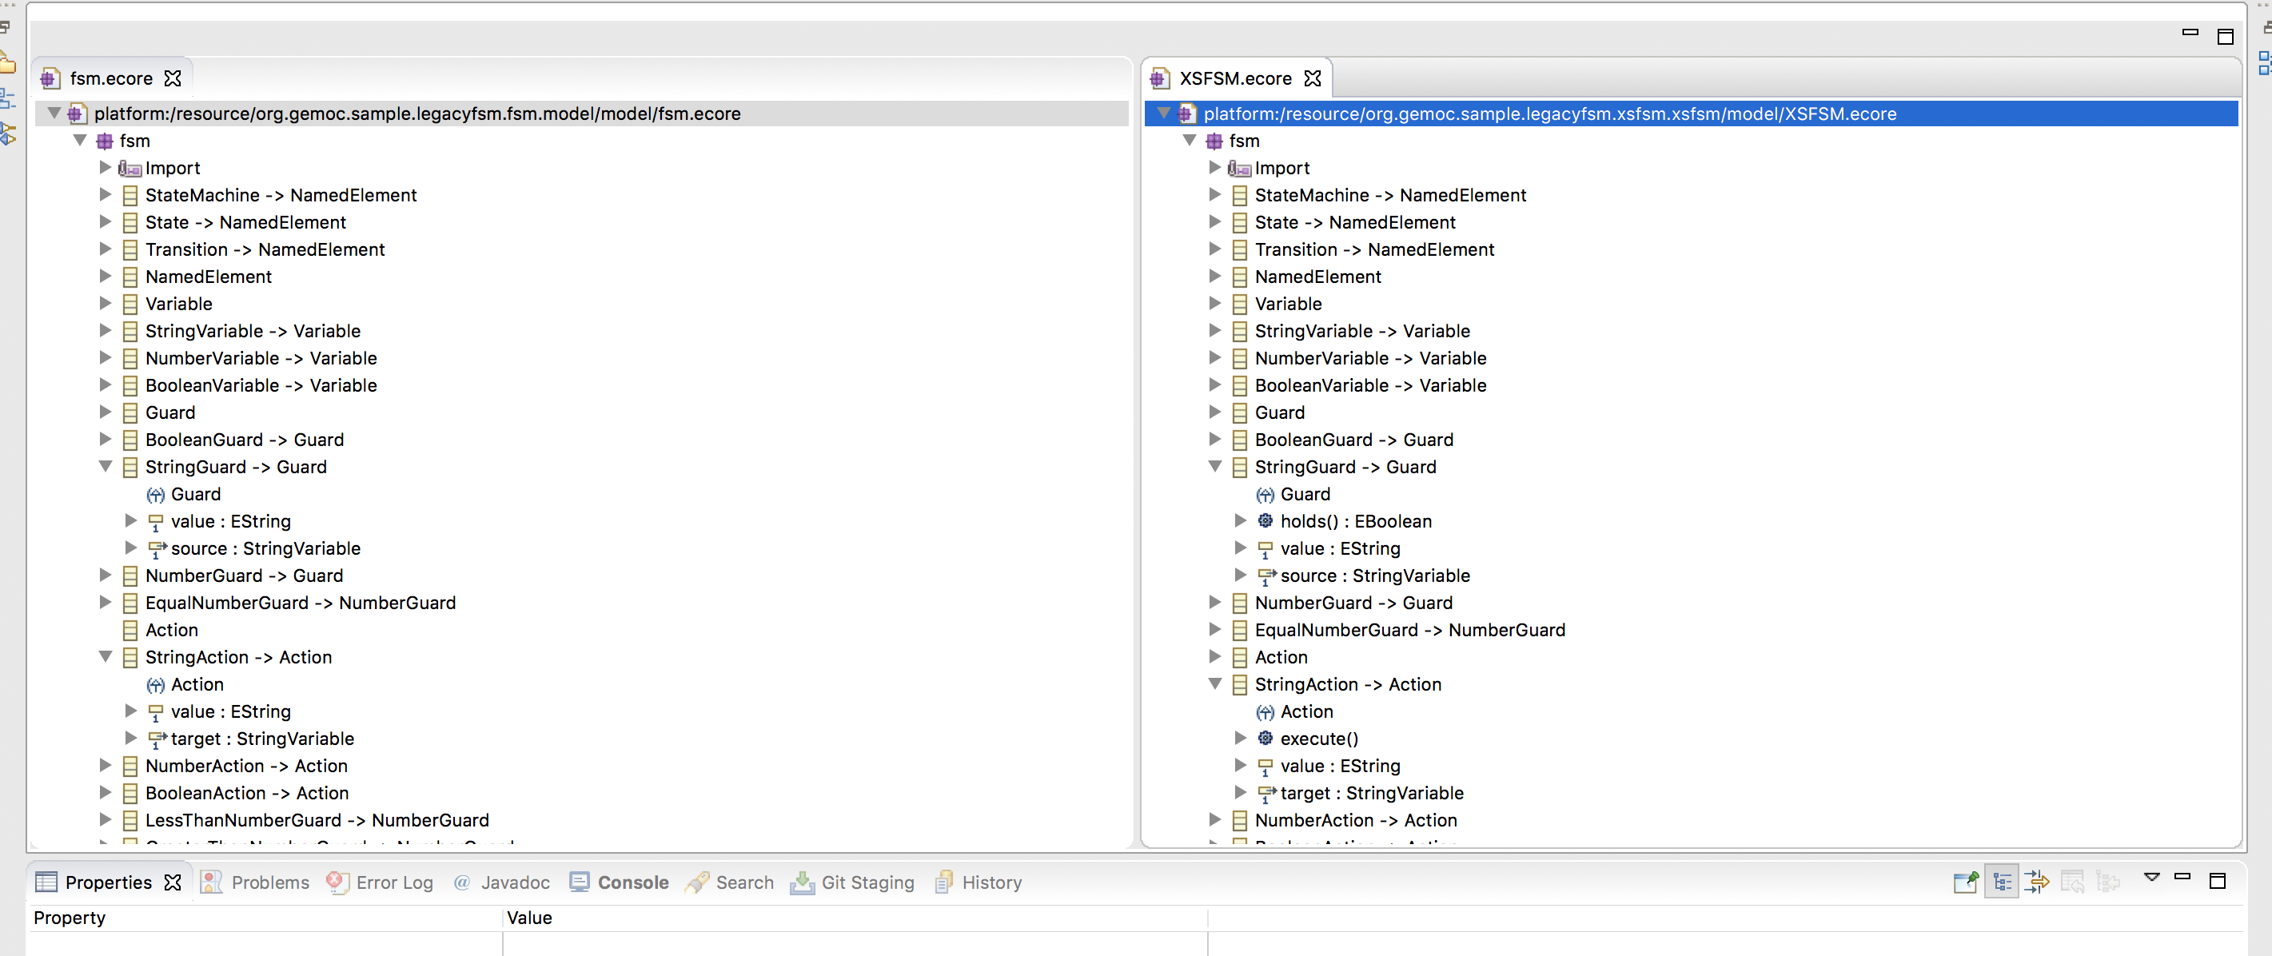
Inspect woven-in operations
new operations
Check metamodel of generated project org.gemoc.sample.legacyfsm.xsfsm
(see https://github.com/gemoc/MODELS2017Tutorial)

Slide 77


Create and run extended model
(see https://github.com/gemoc/MODELS2017Tutorial)

Slide 78
Concrete syntax extension
STEP 2.4

Slide 79
Graphical concrete syntax with Sirius
Another plugin for the eclipse infrastructure
Enables creating graphical editors for ECore metamodels
Editors
(textual, graphical, …)
Checkers
(static & dynamics)
Documentation generators
Compilers
Test generators
Translators
Simulators
Code generators
Analyzers
Refactoring
etc.

Slide 80




Views for language engineers and modelers
Language engineers
Modelers
Specification environment
Runtime environment

Slide 81

Examples of viewpoints

Slide 83
Extend FSM concrete syntax
Define the representation of guards and actions instances for the static perspective.
Define the rendering of variables for the run-time representation.
(see https://github.com/gemoc/MODELS2017Tutorial)

Slide 84

Final representation
stack trace
variable values
textual representation of transition guards and actions
dynamic representation of variable values
tracing
(see https://github.com/gemoc/MODELS2017Tutorial)

Slide 85

Mind the different perspectives
(see https://github.com/gemoc/MODELS2017Tutorial)

Slide 86
WRAP-UP and Discussion
PART 3

Slide 87
Reifying concurrency in executable DSLs
Concurrency remains implicit and ad-hoc in language design and implementation:
Design: implicitly inherited from the meta-language used
Implementation: mostly embedded in the underlying execution environment
The lack of an explicit concurrency specification in language design prevents:
leveraging the concurrency concern of a particular domain or platform
a complete understanding of the behavioral semantics
effective concurrency-aware analysis techniques
effective techniques for producing semantic variants
analysis of the deployment on parallel architectures

Slide 88
Activity diagram debugger
https://github.com/gemoc/activitydiagram

Slide 89
Coping with semantic variation points
Florent Latombe, Xavier Crégut, Julien Deantoni, Marc Pantel, Benoit Combemale, "Coping with Semantic Variation Points in Domain-Specific Modeling Languages", In EXE@MoDELS 2015.

Slide 90

Summary of the sequential approach

Slide 91

Concurrency management

Slide 92

Model coordination
Once the event notion has been reified, it is then possible to reason about it.
i.e., un several models at the same time and coordinate them
In GEMOC we have, the Behavioral Coordination Operator Language

Slide 93




generates
generates
generates
generates
generates
generates
Language 2
Language 2
Language 2
Language 2
Language 2
Language 2
Conforms to
Conforms to
Conforms to
Conforms to
Conforms to
Conforms to
System
Designer
System
Designer
System
Designer
System
Designer
System
Designer
System
Designer
defines
defines
defines
defines
defines
defines
Model 1
Model 1
Model 1
Model 1
Model 1
Model 1
Coordination
/
Communication
Coordination
/
Communication
Coordination
/
Communication
Coordination
/
Communication
Coordination
/
Communication
Model 2
Coordination
/
Communication
Model 2
Model 2
Model 2
Model 2
Model 2
Model A
Model A
Model A
Model A
Model A
Model 3
Model A
Model 3
Model 3
Model 3
Model 3
Model 3
Model B
Model B
Model B
Model B
Model B
Model B
Model B
Model B
Model B
Model B
Model B
Model B

Slide 94
Behavioral Model Coordination
Matias Ezequiel Vara Larsen, Julien Deantoni, Benoit Combemale, Frédéric Mallet, "A Behavioral Coordination Operator Language (BCOoL)," In MODELS 2015

Slide 95
Take-away messages
DSLs are important (as intuited for a long time – it will become more and more apparent)
DSL technology is here and ready to use
Over 30 language workbenches in the wild (cf. http://2016.splashcon.org/track/lwc2016)
Software language engineering is maturing to support MDE

Slide 96
Wrap-up and discussion
Today you have
executed models of the FSM language
extended its metamodel with new variables, guards, and transitions using Ecore
restricted it with OCL well-formedness rules using OclInEcore
augmented its dynamic semantics to consider the new modeling elements using Kermeta
extended its concrete graphical syntax and editor using Sirius
combined two modeling languages to produce executable architecture models using Melange
Tomorrow you would
Use other meta programming approaches (ALE, XMOF)
Bring textual concrete syntax to editors and animators (Xtext)
Add concurrency constraints into the behavioral semantics of domain specific concepts (MOCCML)
Coordinate heterogeneous executable modeling languages to support concurrent model execution (BCOoL)

